Slide 1


UNDERSTANDING THE
SDLC MODEL

Slide 2
WHAT IS SDLC?
Definition: The Software Development Life Cycle (SDLC) is a systematic process for planning, creating, testing, and deploying an information system.
Importance: Ensures high-quality software that meets or exceeds customer expectations, reaches completion within time and cost estimates.

Slide 3
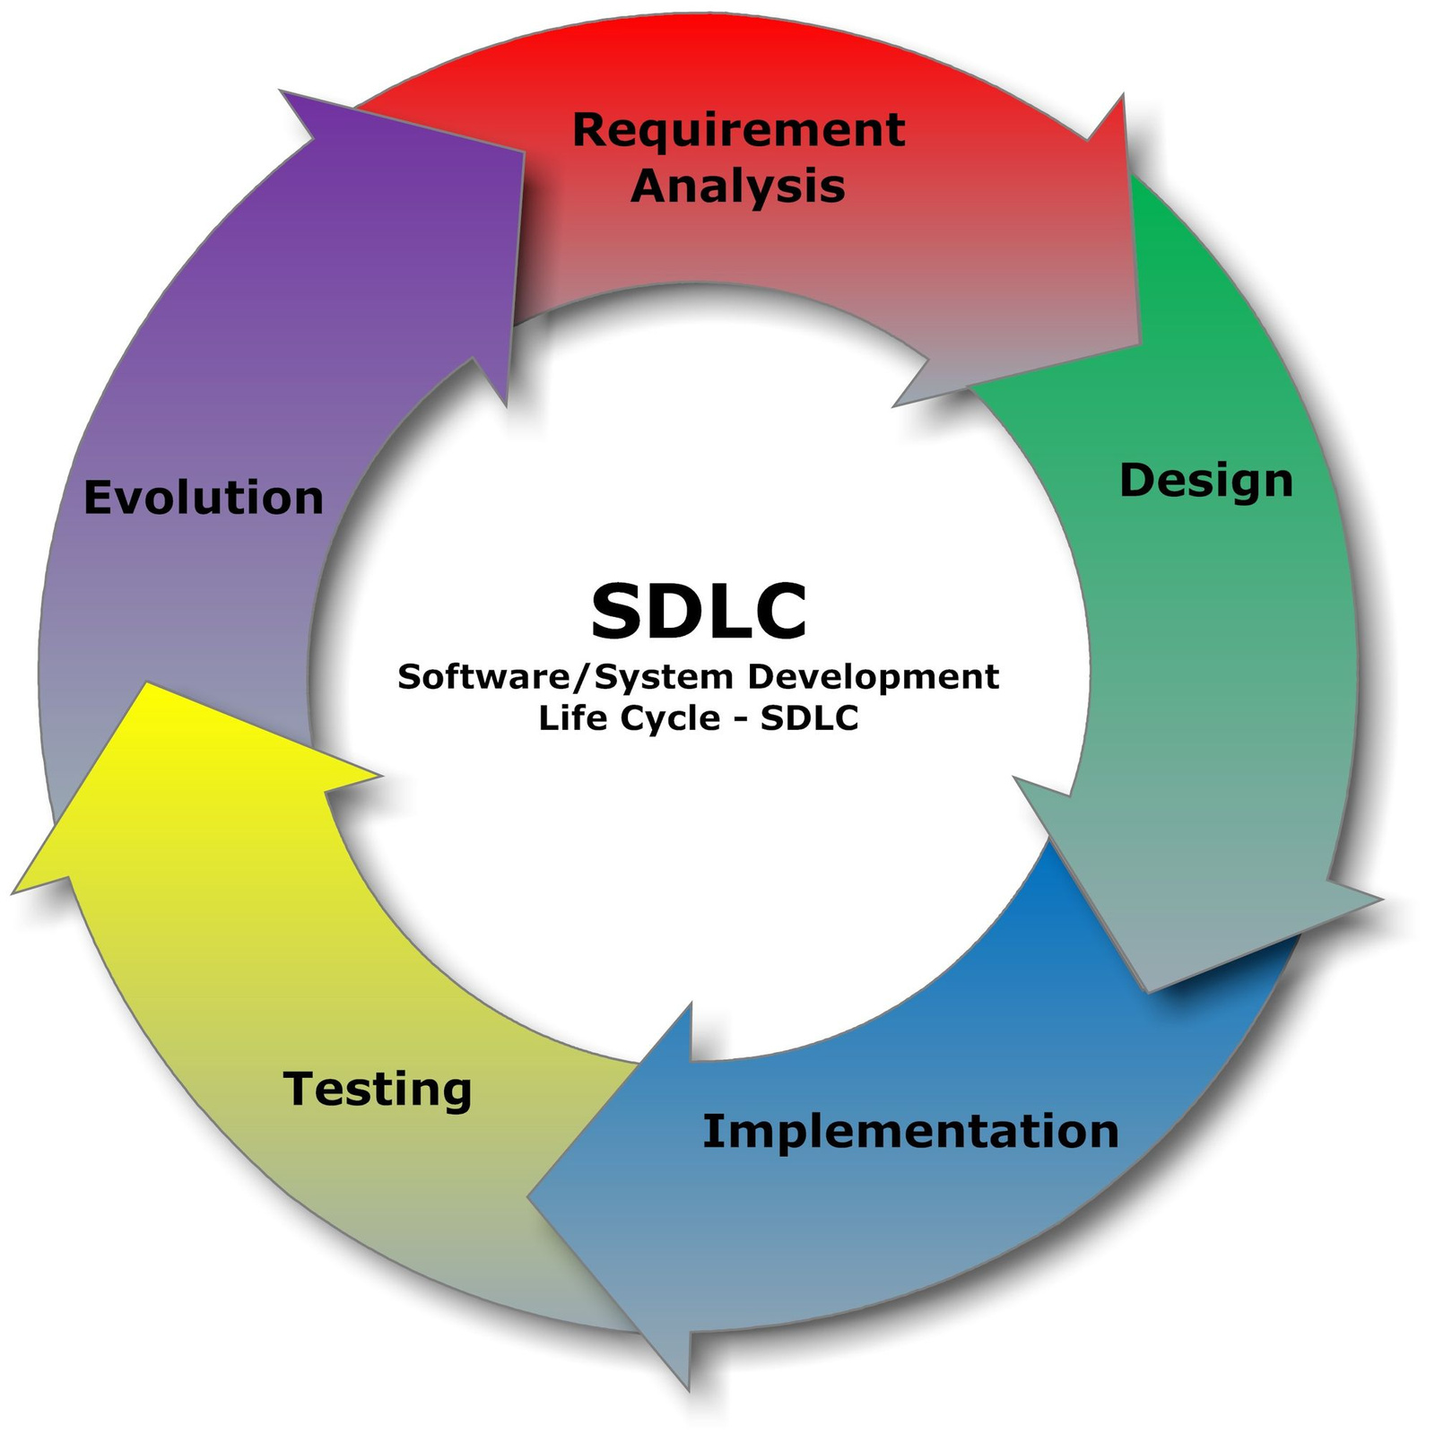
PHASES OF SDLC

Slide 4
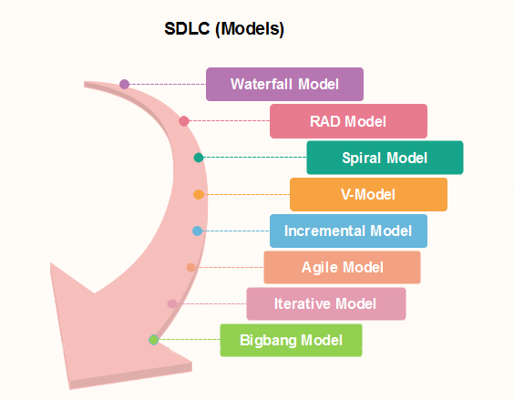
POPULAR SDLC MODELS:

Slide 5

WATERFALL MODEL
Description:
Sequential design process
Each phase must be completed before the next begins
Pros:
Simple and easy to understand
Well-suited for smaller projects with clear requirements
Cons:
Inflexible to changes
Poor model for complex and object-oriented projects

Slide 6
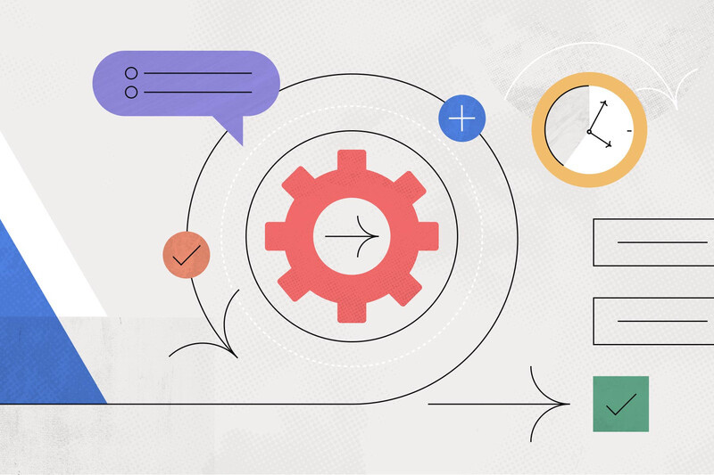

AGILE MODEL
Description:
Iterative and incremental model
Promotes adaptive planning and flexibility
Pros:
High customer satisfaction
Flexibility to changes
Frequent delivery of functional software
Cons:
Requires constant communication
Less predictable due to frequent changes

Slide 7
ITERATIVE AND SPIRAL MODELS
Iterative Model:
Develops system through repeated cycles (iterations)
Pros:
Detects issues early
Flexibility in design
Cons:
Requires good planning and design
Can be costly
Spiral Model:
Combines iterative development with risk management
Pros:
Focuses on risk analysis
Suitable for large, complex projects
Cons:
Can be expensive
Requires expertise in risk analysis

Slide 8


V-MODEL
Description:
Extension of the Waterfall model
Each development stage is associated with a testing phase
Pros:
Simple and easy to use
Emphasizes verification and validation
Cons:
Rigid and less flexible
Not suitable for large, complex projects

Slide 9
CONCLUSION
SDLC is crucial for systematic software development
Different models serve different project needs
Choosing the right model depends on project requirements, complexity, and resources
ned.

Slide 10

THANK YOU!

